Slide 1
RETENCION

Slide 2
Objective: Build end to end analytical solution for customer retention in telecom industry
Solution Features:
Our solution will have ability to consume data from multiple sources
Customer Billing information
Customer complaints
CDR data
Signal strength data
Customer demography data
It will estimate PTC (Propensity to Churn prediction) for each customer
Visualization using dashboard on:
How the propensity is moving over time for each customer (RED)
Factors affecting churn
Segment of customer moving out/ Geography /Demography

Slide 3


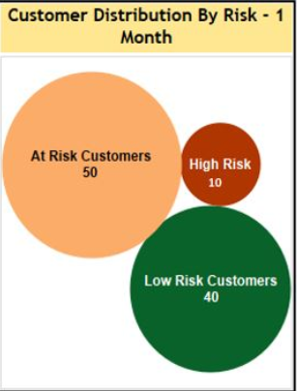


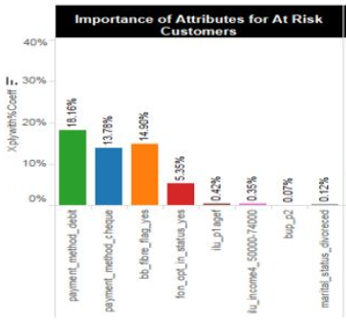



Architecture
Key Data Systems
Data staging and ETL
ML Model Building Layer
Model Training/Build
Batch Layer
Trained Model
Model evaluation
Flask/falcon/python inliner
Call Detail Record
System
ABT Preparation process
Model predictions
Billing
System
Model metrics and performance
Data Visualization
CRM
System
AWS Hadoop AMI
Technology stack : AWS Hadoop AMI(Amazon machine image), Hadoop(Spark, Hive, HDFS frameworks), Python, REST API, Visualization tool/scripting

